Slide 1

Operating Systems
Jinghui Zhong （钟竞辉）
Office：B3-515
Email ：jinghuizhong@scut.edu.cn

Slide 2
PPT submission link:
https://send2me.cn/25s82LtU/TSaQ2Cqdhuwh1Q

Slide 3

单选题
1分
In a paging system, the FIFO page replacement algorithm is used, when the number of pages allocated by the process increases, the number of page faults will（）
A
decrease
B
increase
C
No influence
D
may increase or decrease
提交

Slide 4
主观题
1分
正常使用主观题需2.0以上版本雨课堂
作答

Slide 5
Answer: (k*1 + n)/k = 1 + n/k
5

Slide 6
Segmentation
Programmer’s view memory is not usually as a single linear address space:
Main function
Function1
Symbol table
Programmer doesn’t know how large these will be, or how they will grow, and doesn’t want to manage where they go in virtual memory.
6

Slide 7
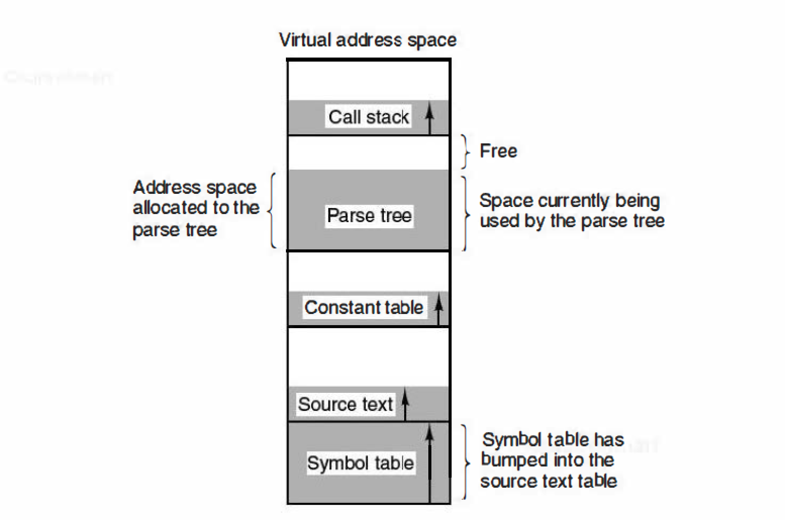
Compiler with One-dimensional Address Space
7

Slide 8
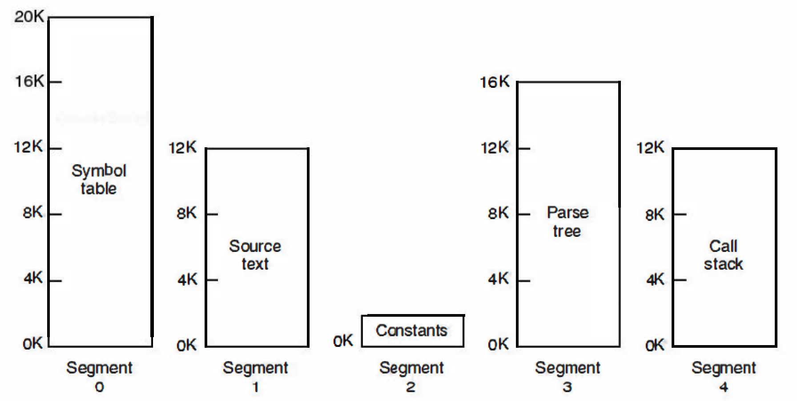
Compiler with Segmentation
Segmentation maintains multiple separate virtual address spaces per process.
Allows each table to grow or shrink, independently.
8

Slide 9
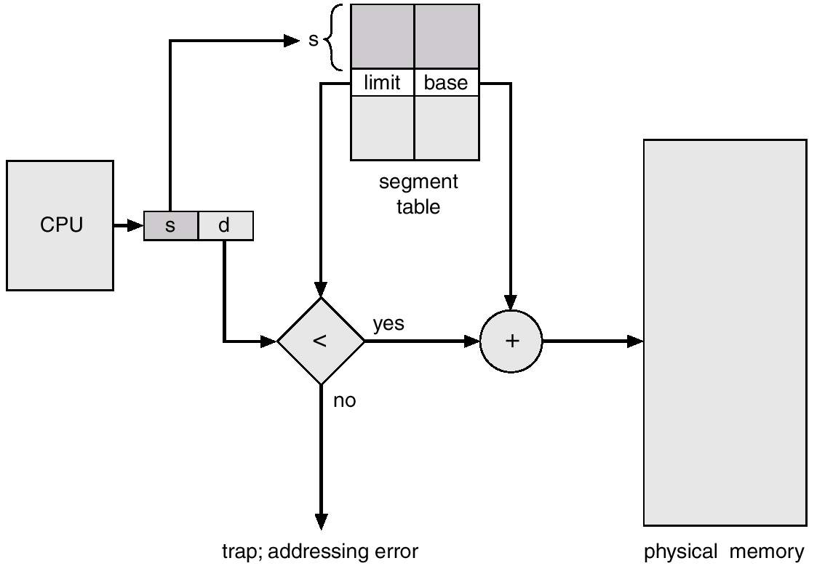
Pure Segmentation
9

Slide 10
Segmentation
A segment is a logically independent address space.
segments may have different sizes
their sizes may change dynamically
the address space uses 2-dimensional memory addresses and has 2 parts:
(segment #, offset within segment)
segments may have different protections
allows for the sharing of procedures and data between processes.
10

Slide 11
Segmentation with Paging (MULTICS)
CPU
Y
d < limit?
Main
memory
N
D
S
D
Segment table
error
p
d’
+
page table
limit
PT base
f
f
d’
Physical
address
11

Slide 12

Segmentation

Slide 13
单选题
1分
Which memory management method provides one-dimensional address structure ()
A
Segmentation
B
Paging
C
Segmentation with Paging
D
None of the above
提交

Slide 14
单选题
1分
In which memory management scheme, jobs are required to occupy continuous memory space.
A
Fixed partition
B
Paging
C
Segmentation
D
Segmentation with paging
提交

Slide 15
单选题
1分
Which method will not generate internal fragmentation （ ）
A
Paging
B
Segmentation
C
Fixed partition
D
Segmentation with paging
提交

Slide 16
单选题
1分
Which method can make the memory fragmentation as little as possible, and make the memory utilization rate higher ?
A
Fixed partition
B
Variable partition
C
Paging
D
Segmentation with paging
提交

Slide 17
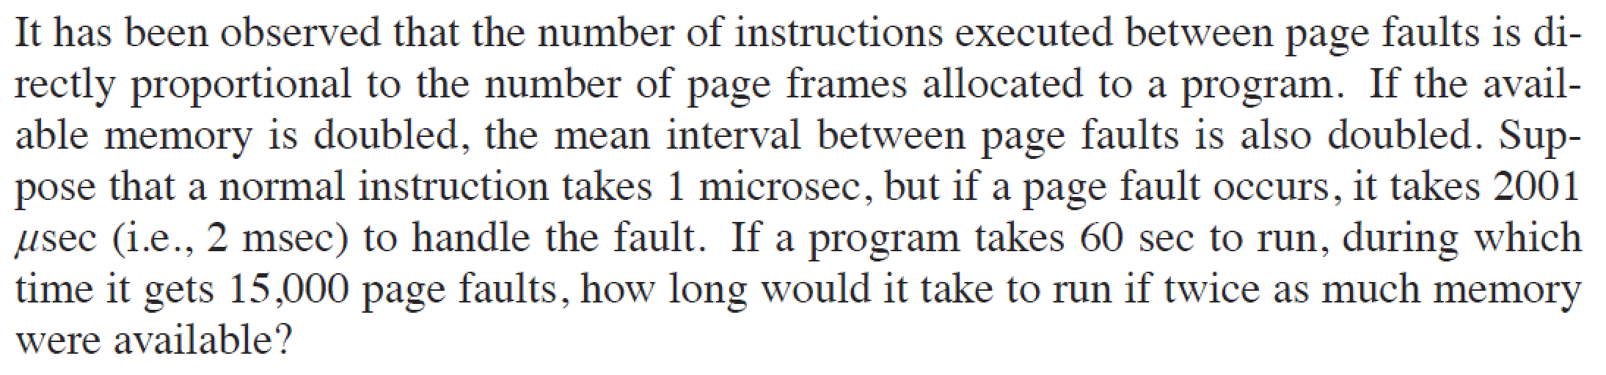
主观题
1分
正常使用主观题需2.0以上版本雨课堂
作答

Slide 18
Answer: suppose the normal time without page fault handling is A
Then: A+ 15000 * 2ms = 60s; ➔ A = 30s;
So, when the memory size is doubled, the total execution time is:
A + 0.5 * (15000 * 2ms) = 30s + 15s= 45s;
18

Slide 19
主观题
1分
There is a matrix a[100] [200]. The LRU is used in a virtual system. The system gives the process five pages to store data a, and each page can store 200 integers. The program needs to initialize the whole array. When storing the array, it is stored by line. Try to calculate the page fault times of each of the following two programs
program1： for(i = 0; i<=99; i++)
for(j = 0; j<=199; j++)
a[i][j] = i * j;
program2: for(j = 0; j <=199; j++)
for(I=0;i<=99;i++)
a[i][j] = i * j;
正常使用主观题需2.0以上版本雨课堂
作答

Slide 20
Each row of the array can be placed on one page.
For program 1: each page is called once, and page fault occur on each page called, so 100 page faults will be generated;
For program 2: when J = 0, every time a number is read, a new page needs to be transferred in, resulting in 100 page faults; Therefore, the total number of page faults is: 200 * 100 = 20000

Slide 21
主观题
10分
There is a paging system, and the page table is stored in registers. If a replaced page has not been modified, it takes 8ms to process a page fault; If the replaced page is modified, it takes 20ms to process a page fault. The memory access time is 1 µs, and the time to access the page table is ignored. Assuming that 70% of the replaced pages have been modified, what is the maximum page fault rate to ensure that the effective access time does not exceed 2 µs?
正常使用主观题需2.0以上版本雨课堂
作答

Slide 22
There is a paging system, and the page table is stored in registers. If a replaced page has not been modified, it takes 8ms to process a page fault; If the replaced page is modified, it takes 20ms to process a page fault. The memory access time is 1 µs, and the time to access the page table is ignored. Assuming that 70% of the replaced pages have been modified, what is the maximum page fault rate to ensure that the effective access time does not exceed 2 µs?
Suppose the page fault rate is p，then:
(1-p)*1µs + p*(0.7 * 20ms + 0.3 * 8ms + 1µs) <=2µs
So, p < 1/16400 = 0.00006

Slide 23
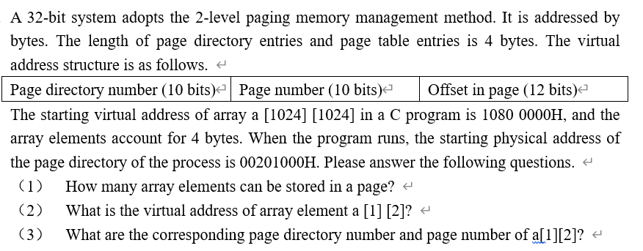
主观题
10分
正常使用主观题需2.0以上版本雨课堂
作答

Slide 24
Answer：
The size of one page is 2^12B = 4KB; → the number of elements in a page = 4KB/4B = 1K;
1080 0000H → Page address:10800H ; offset: 000H
→ the virtual address of a[1][2] is 10801H + 4 * 2 = 10801008H;
10801008H = 0001000010 0000000001 0000000010000, → page directory number = 042H, page number = 001H.

Slide 25
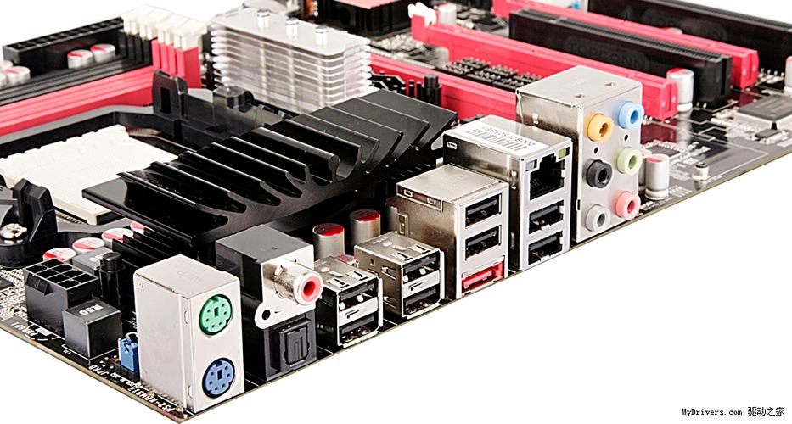

I/O Device

Slide 26
I/O Device
Two common kinds of I/O devices:
Block device: stores information in fixed-size blocks.
Character device：delivers or accepts a stream of characters, without regard to any block structure.
Special device: e.g., clocks.

Slide 27
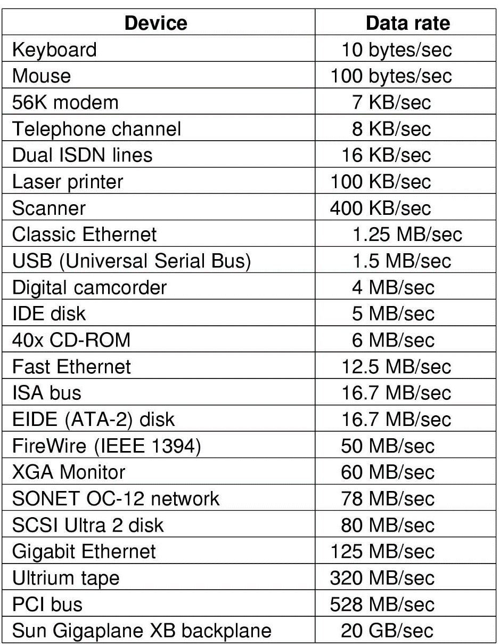
Principles of I/O Hardware
I/O devices cover a huge range in speeds

Slide 28
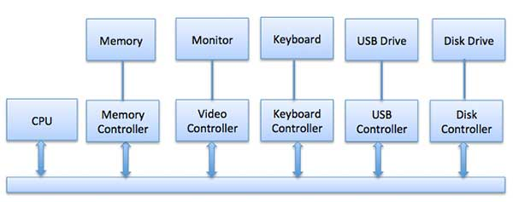
Device Controllers
Components of I/O devices:
Mechanical component ;
Electronic component：i.e., device controller

Slide 29
Device Controllers
A device controller is a part of a computer system that makes sense of the signals going to, and coming from the CPU.
Each device controller has a local buffer and some registers. It communicates with the CPU by interrupts. A device's controller plays as a bridge between the device and the operating system.

Slide 30
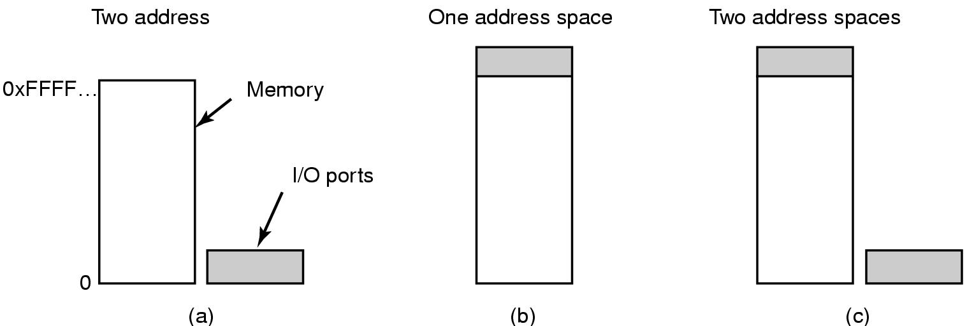
Memory-Mapped I/O
Three approaches:
Each control register is assigned an I/O port number.
All the control registers are mapped into the memory space. This is called memory-mapped I/O.
Mapping I/O data buffers into memory space but separating I/O ports from memory

Slide 31
Memory-Mapped I/O
IN REG, PORT,
OUT PORT,REG
e.g.,
IN R0, 4
and
MOV R0, 4

Slide 32
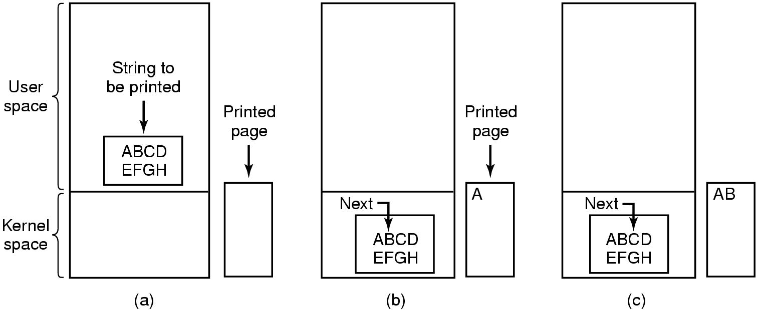
Programmed I/O
Programmed input/output (PIO)
A method of transferring data between the CPU and a peripheral.
Software running on the CPU uses instructions to perform data transfers to or from an I/O device.

Slide 33
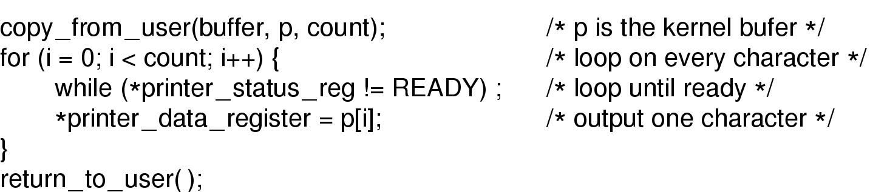
Programmed I/O
Writing a string to the printer using programmed I/O

Slide 34
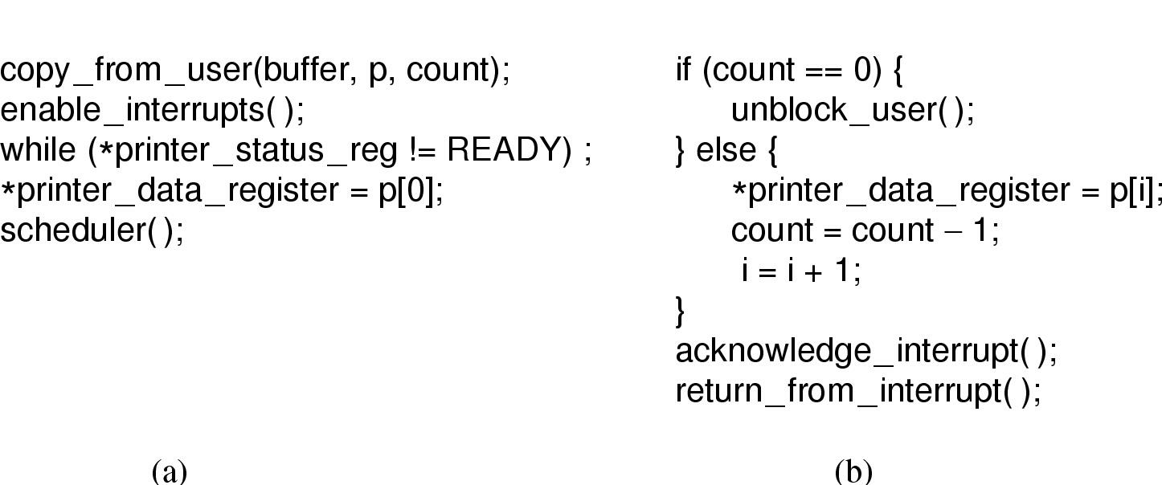
Interrupt-Driven I/O
Writing a string to the printer using interrupt-driven I/O
Code executed when print system call is made
Interrupt service procedure

Slide 35
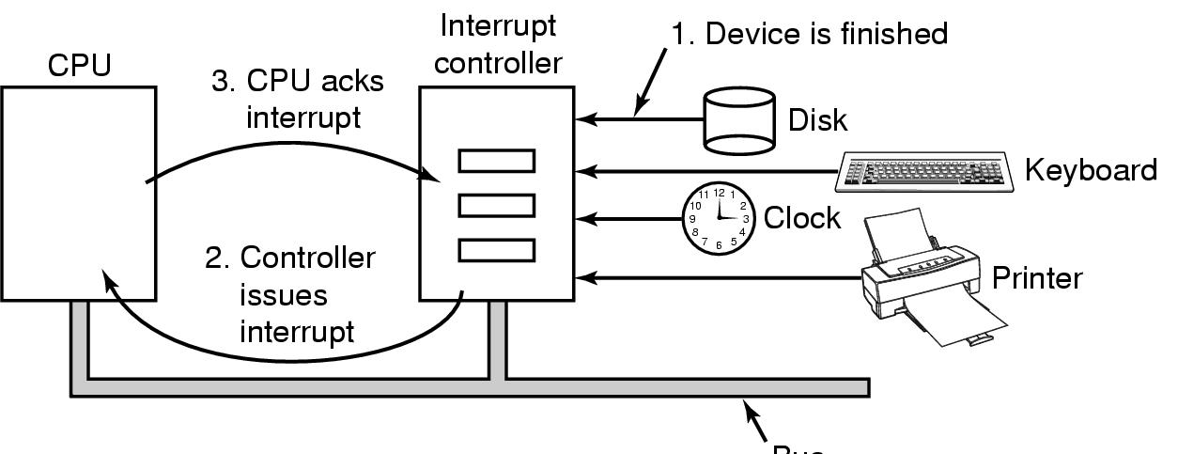
Interrupt
Bus
How interrupts happens?
Connections between devices and interrupt controller actually use interrupt lines on the bus rather than dedicated wires

Slide 36
Interrupt Handlers
Interrupt handlers are best hidden, have driver starting an I/O operation block until interrupt notifies of completion
Interrupt procedure does its task, then unblocks driver that started it.

Slide 37
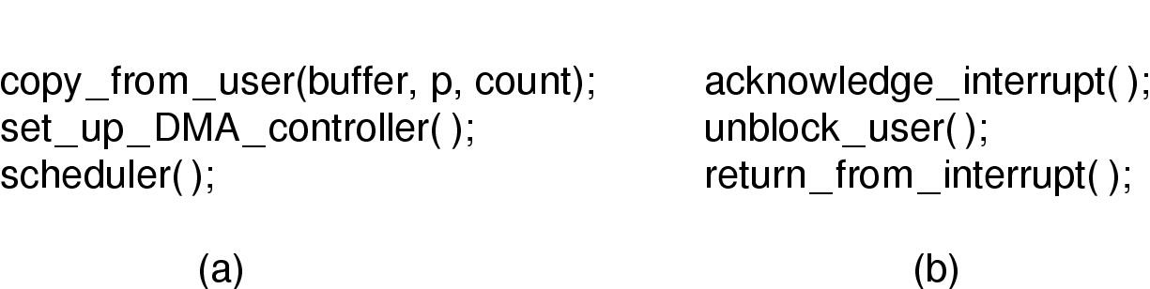
I/O Using DMA
Printing a string using DMA
(a) code executed when the print system call is made
(b) interrupt service procedure

Slide 38
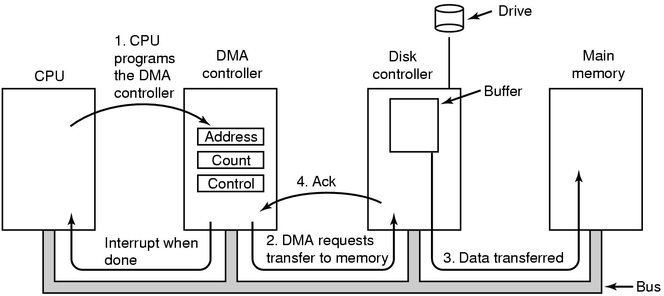
Direct Memory Access (DMA)
Operation of a DMA transfer

Slide 39
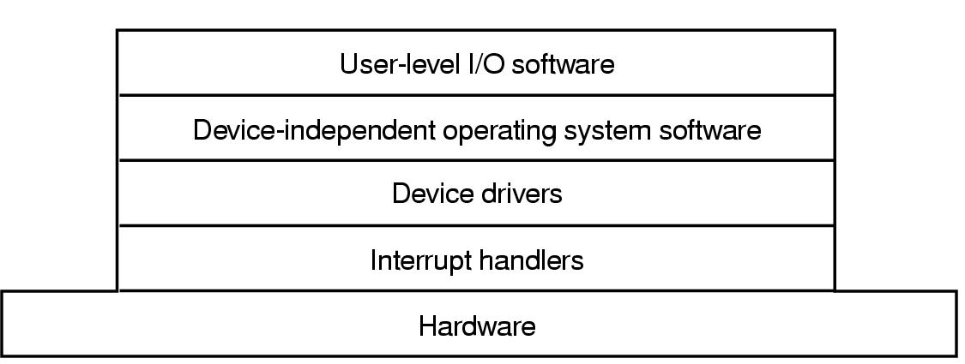
I/O Software Layers
Layers of the I/O Software System

Slide 40
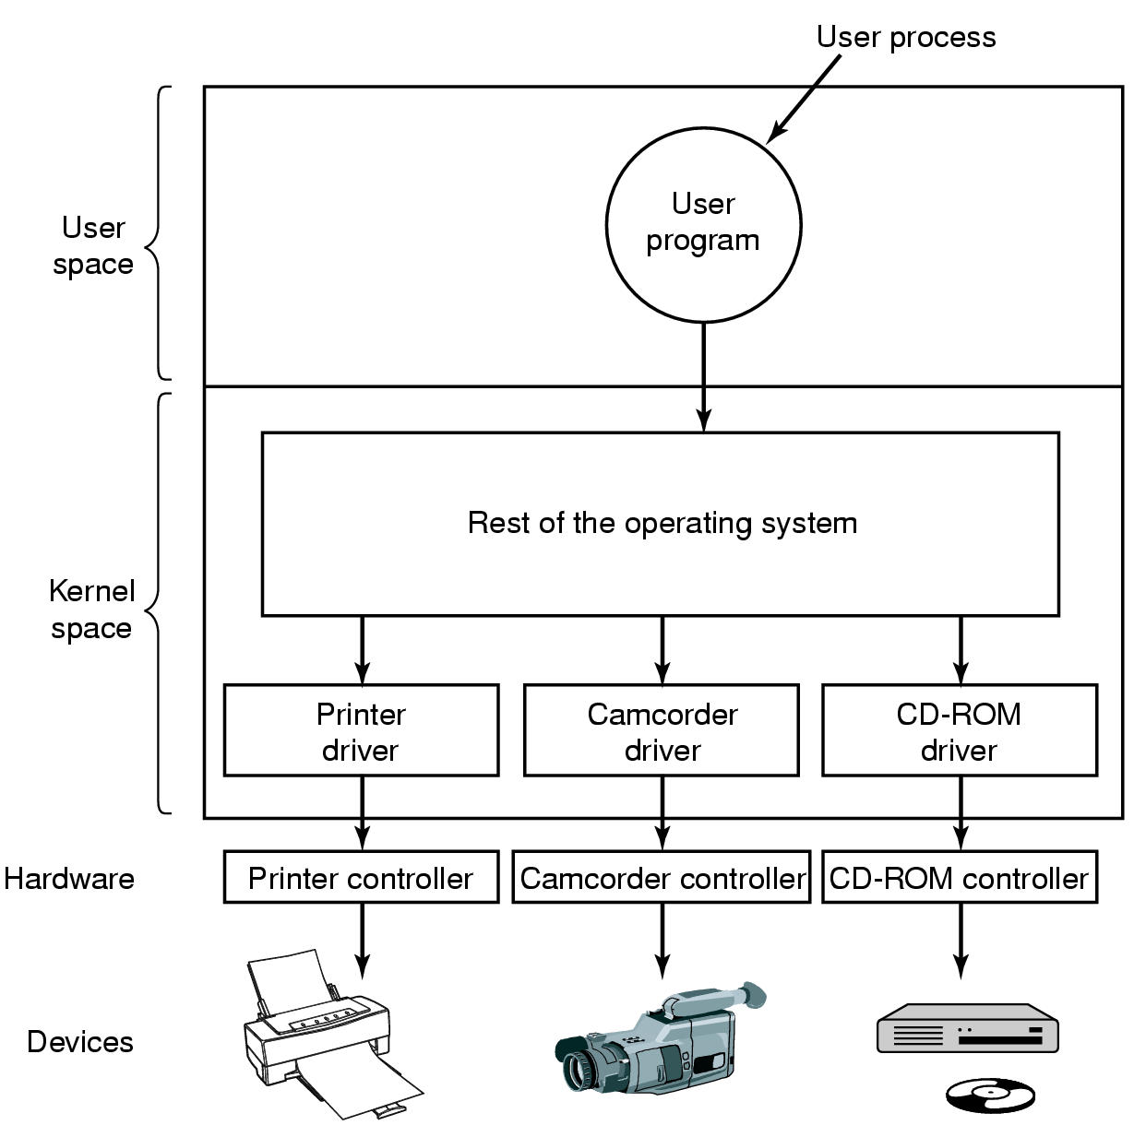
Device Drivers
Communications between drivers and device controllers goes over the bus; Logical position of device drivers is shown in the following figure.

Slide 41
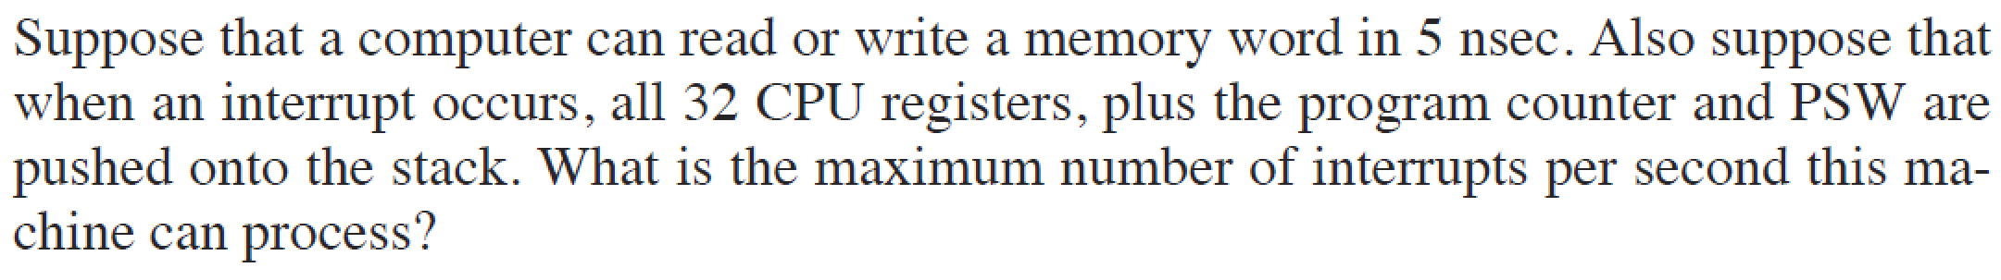
主观题
1分
正常使用主观题需2.0以上版本雨课堂
作答

Slide 42
Answer:
There are totally 34 to be pushed and fetched;
Suppose each register contain a word. Then, the maximum number of interrupts < 1s / (34 * 2 * 5ns).

Slide 43
单选题
1分
If the data exchange between I / O device and memory device is not completed by CPU, the data exchange mode is （）
A
Programming I/O
B
Interrupt driven I/O
C
DMA
D
Unconditional access mode
提交

Slide 44
Check Points
What is Segmentation?
What are the two kinds of IO devices? What are the two components of IO devices.
What is programmed IO、 Interrupt-Driven IO、DMA?
What are the five layers of the IO software system
What are the difference between driver and interrupt handler?
44

